Slide 1





Storage Devices and the Technology behind Programmable Logic Devices:
ROM
PROM
EPROM
EEPROM
Flash memory
PLD

Slide 2
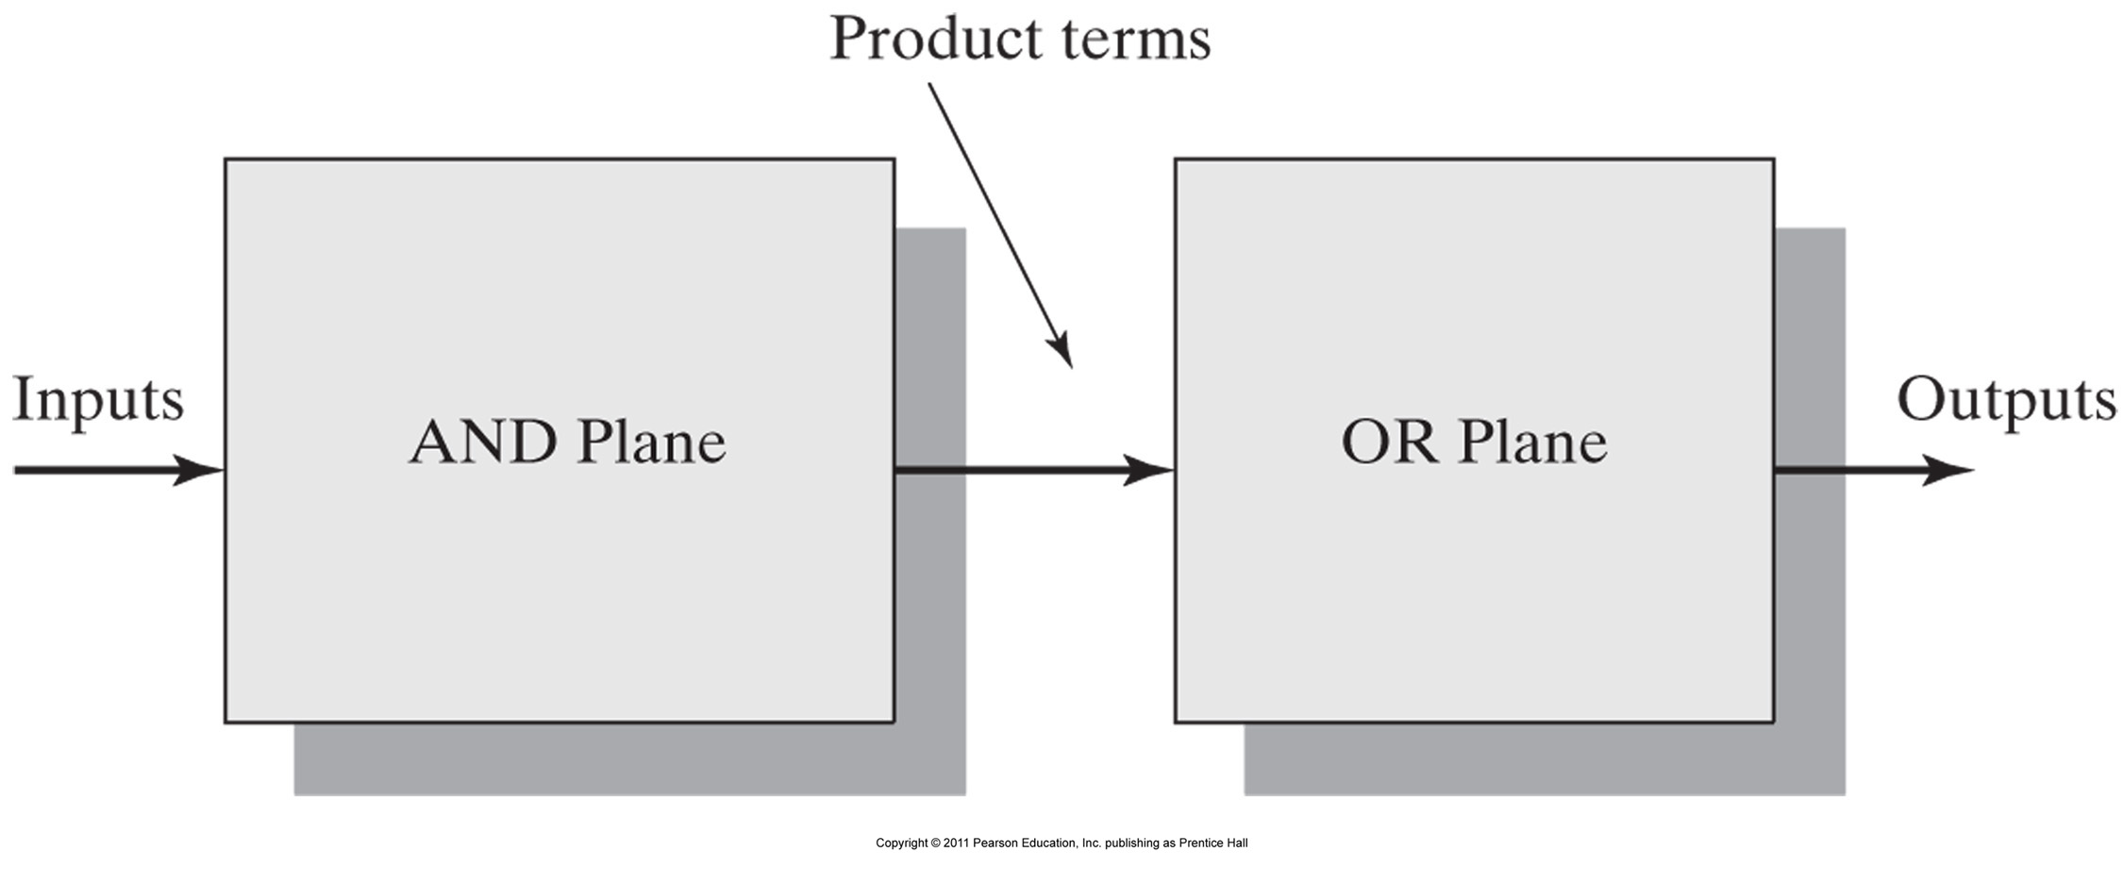
AND-OR plane structure of a programmable logic device

Slide 3
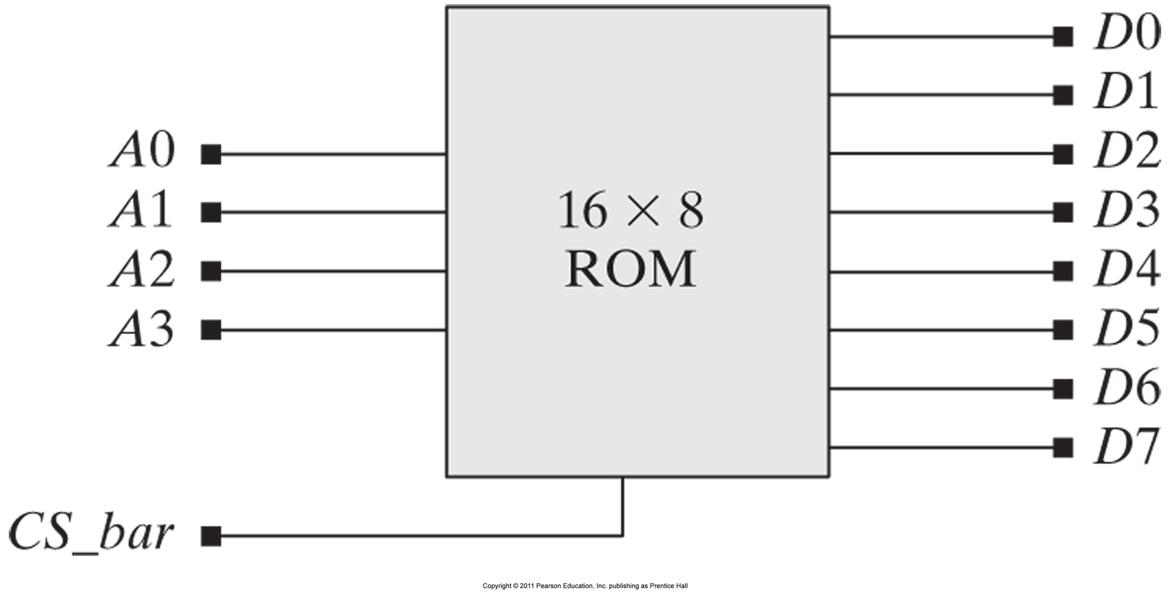
Schematic symbol for a 16 X 8 ROM.

Slide 4
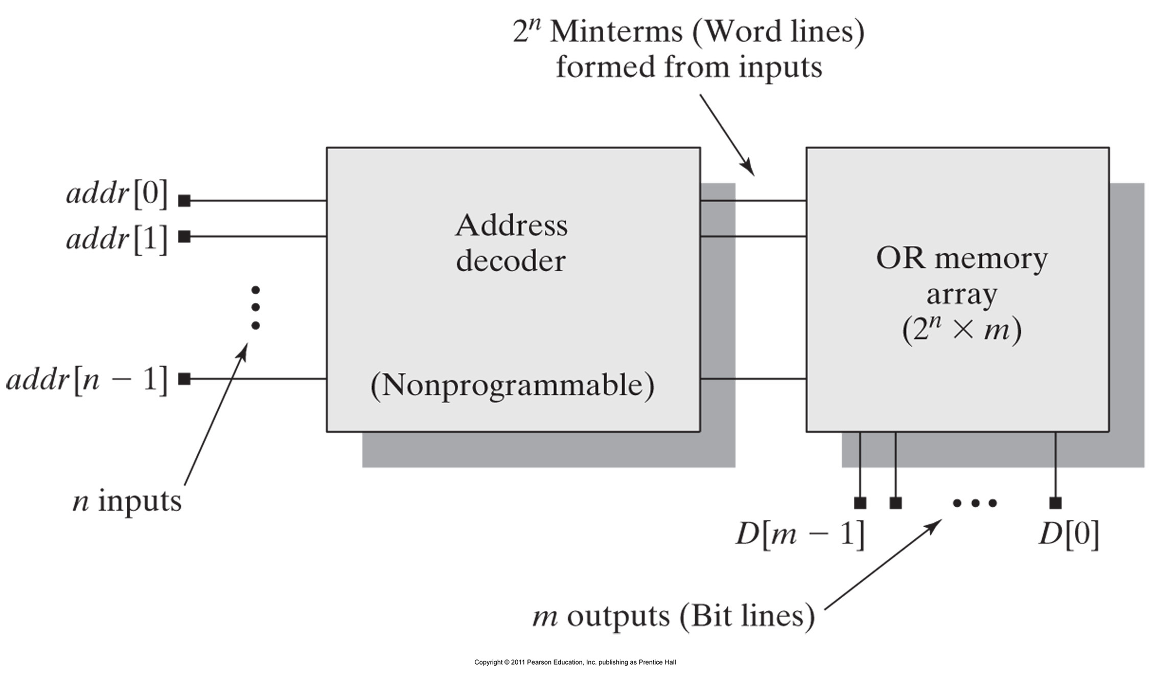
AND-OR planes for a ROM.

Slide 5
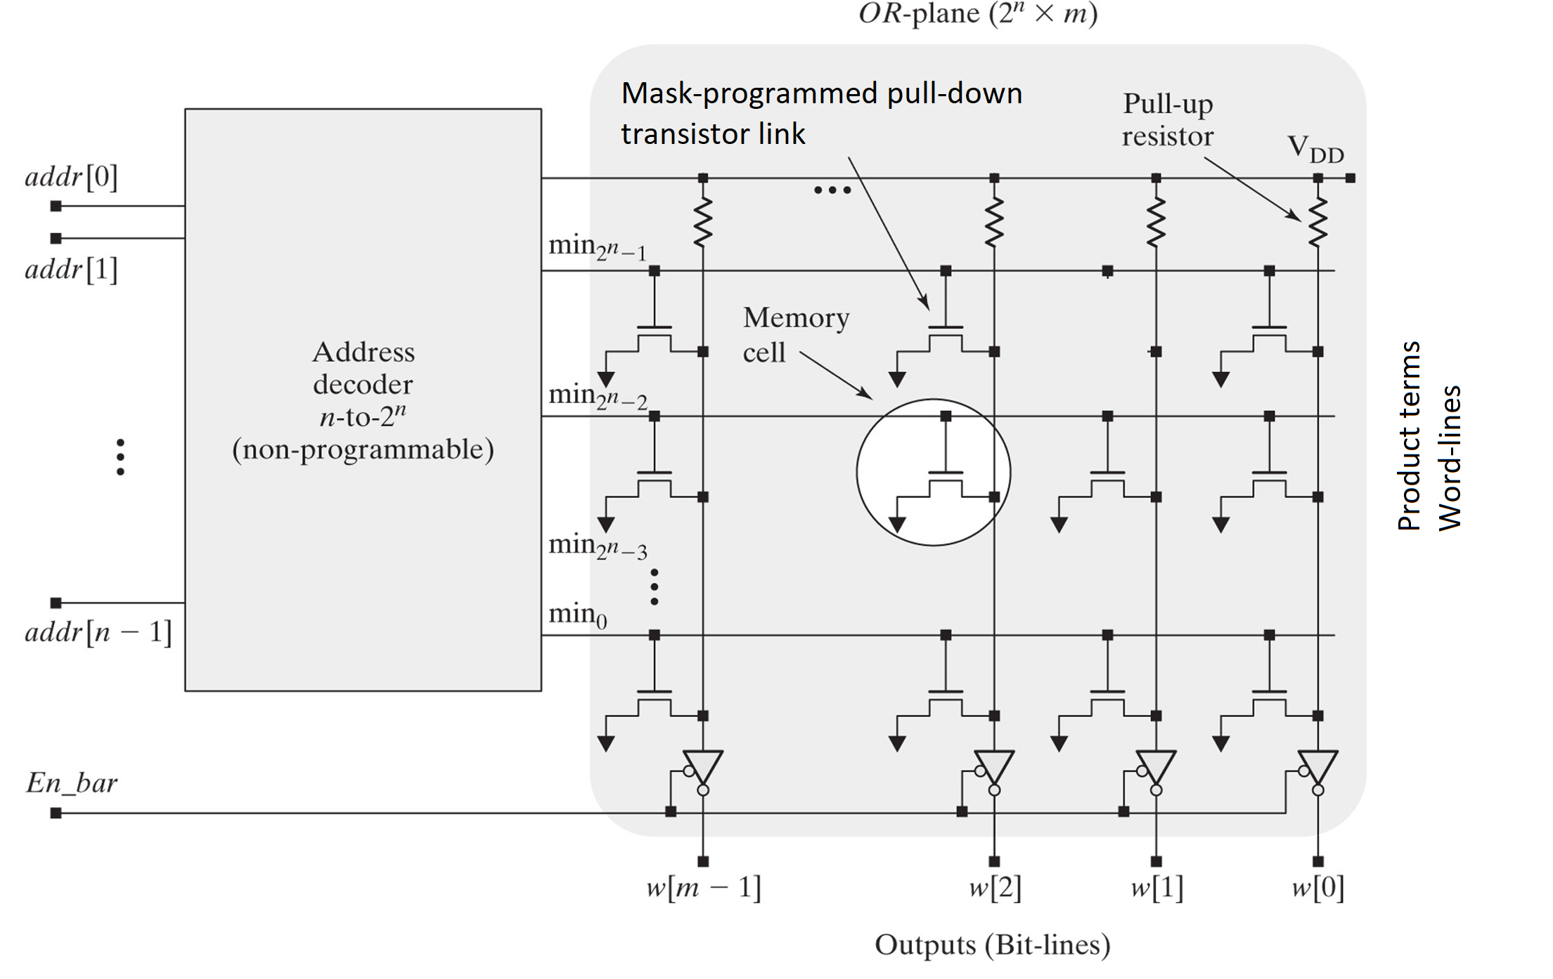

ROM- Circuit structure of a mask-programmed nMOS ROM.

Slide 6
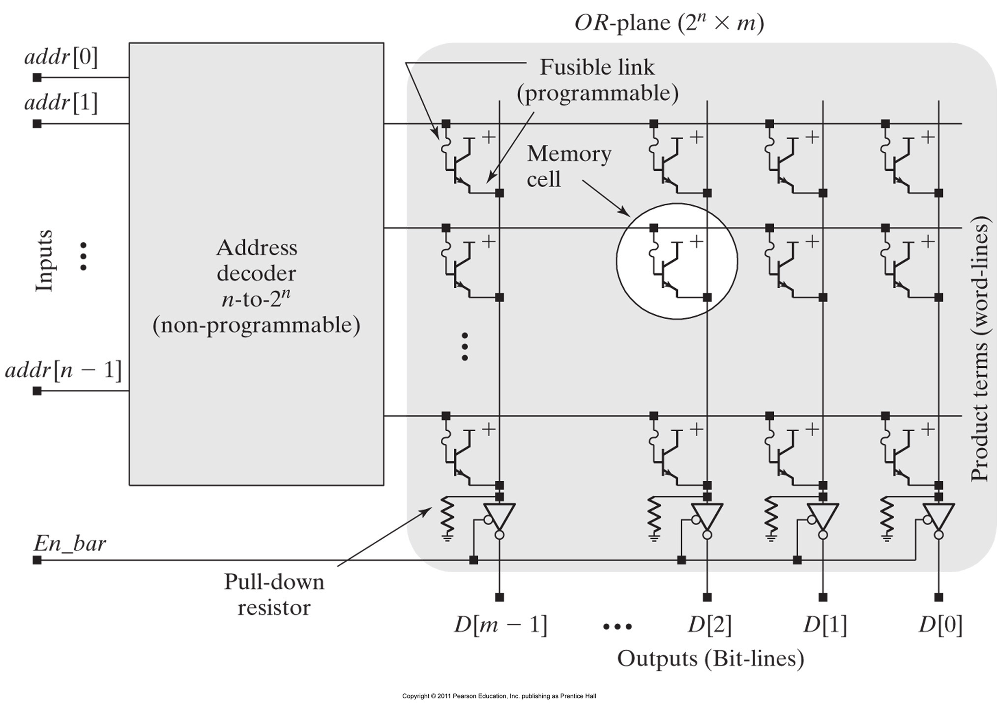
2. Circuit structure for a fusible-link bipolar PROM.

Slide 7
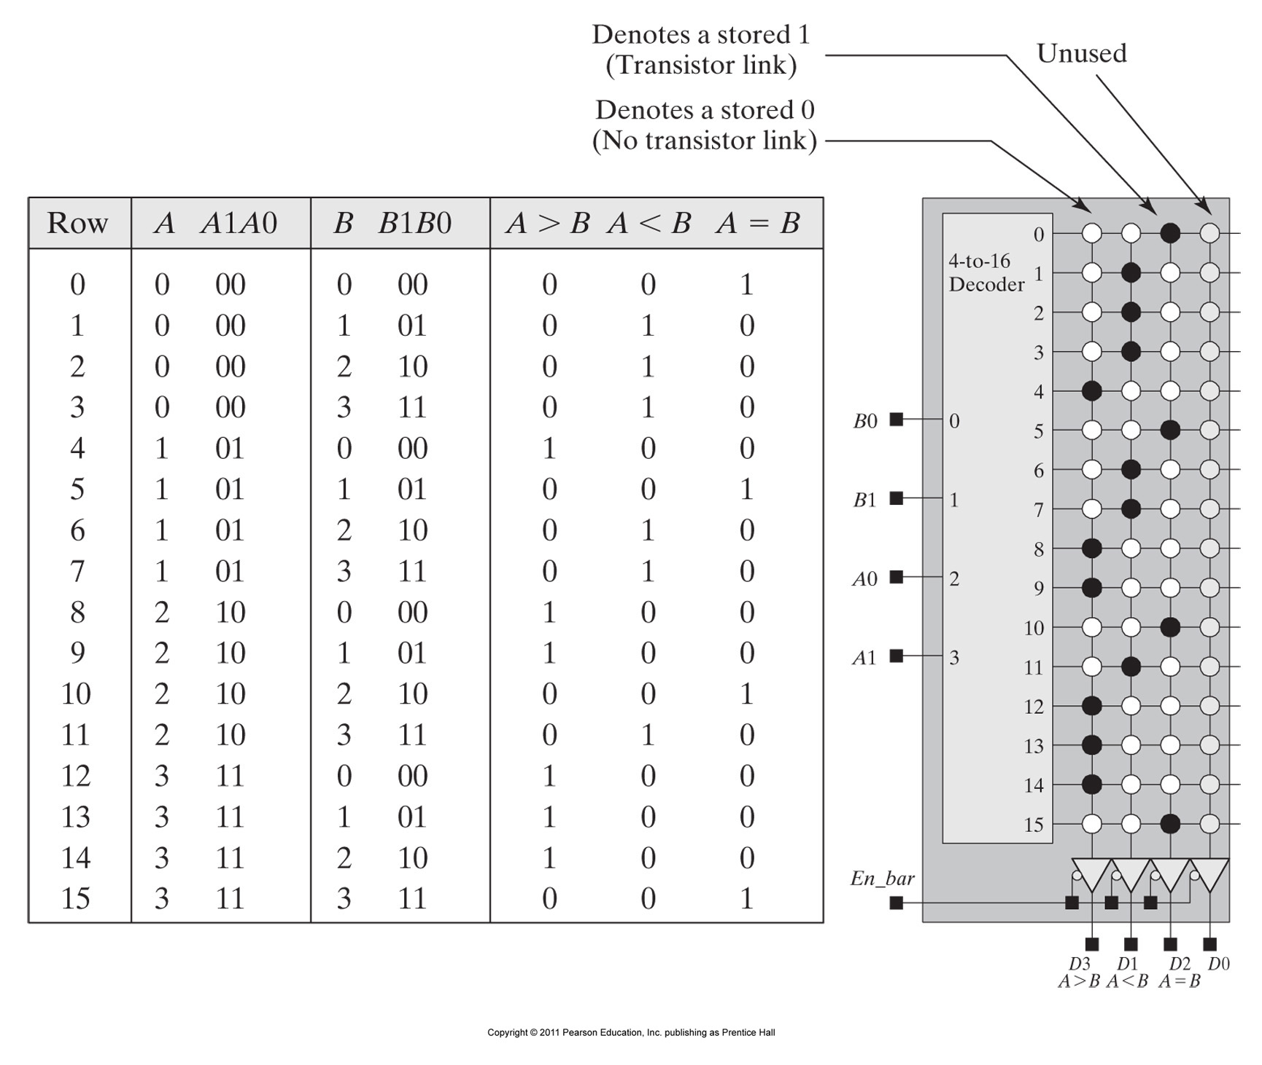
Truth table and PROM fuse map for a 2-bit comparator.

Slide 8
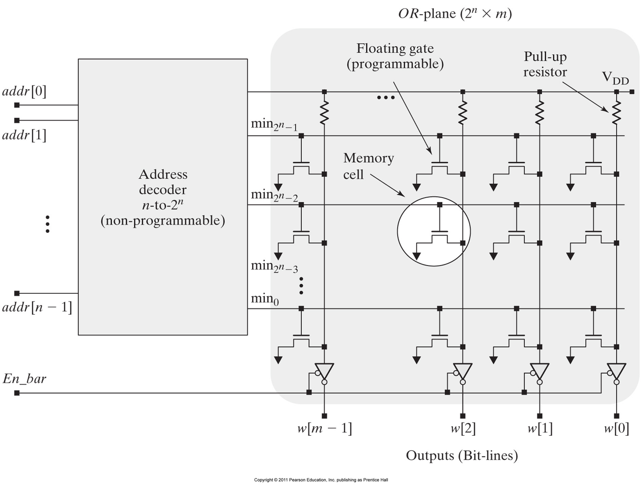
3. Circuit structure for a floating-gate EEPROM.

Slide 9
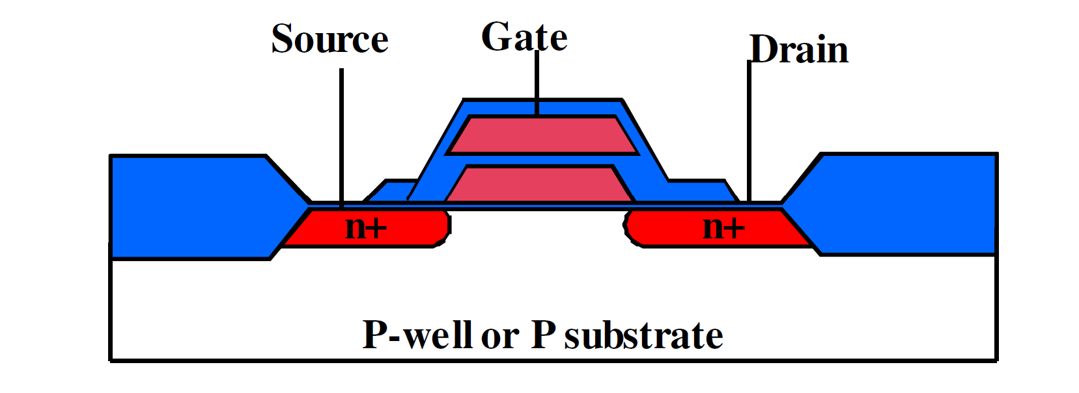
3. Floating-gate EEPROM Technology

Slide 10
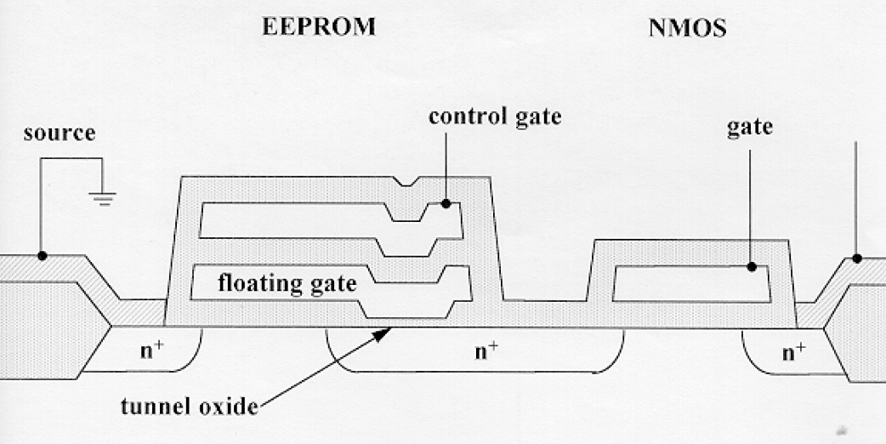
3. Floating-gate EEPROM Technology

Slide 11
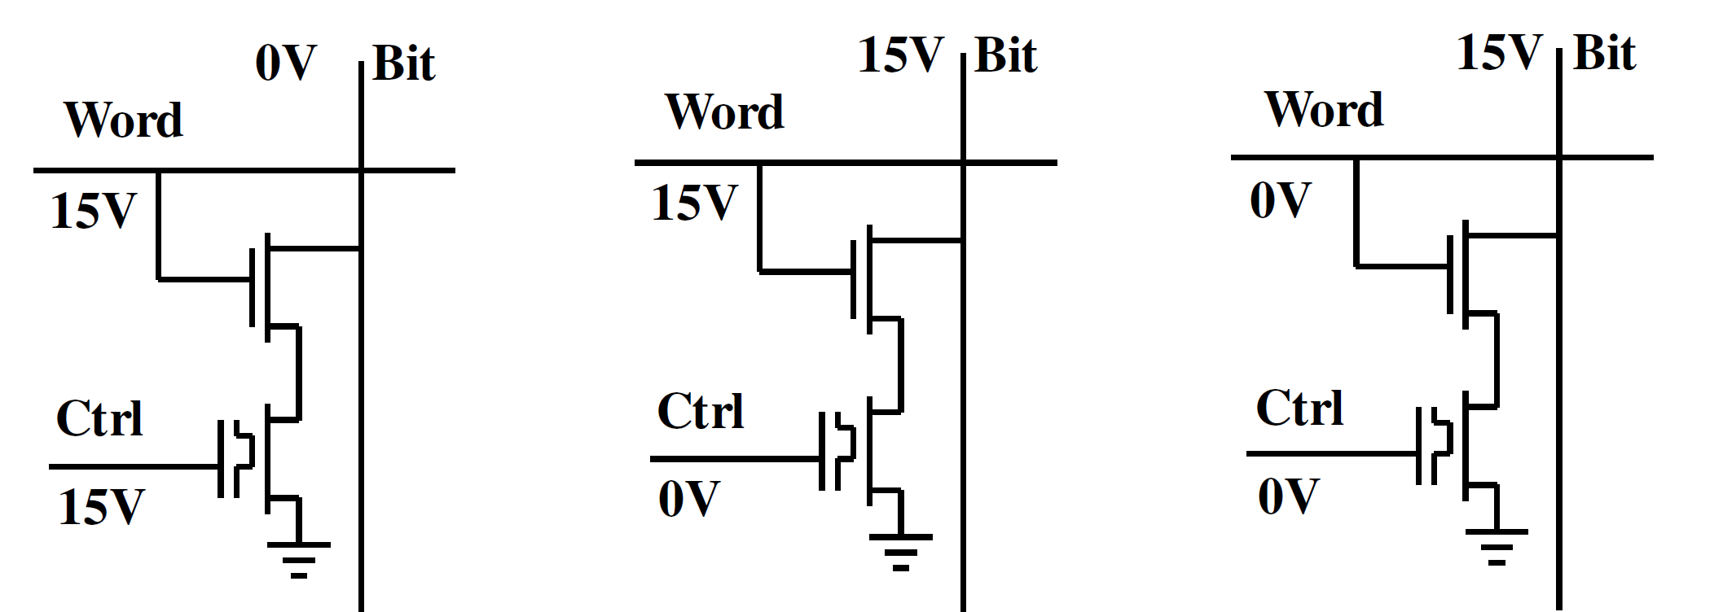
3a. Programming the EEPROM cell
Precharging the floating gate with electrons
Write a 0.
Remove electrons from floating gate.
Write a 1.
Keep electrons trapped on the floating gate.

Slide 12
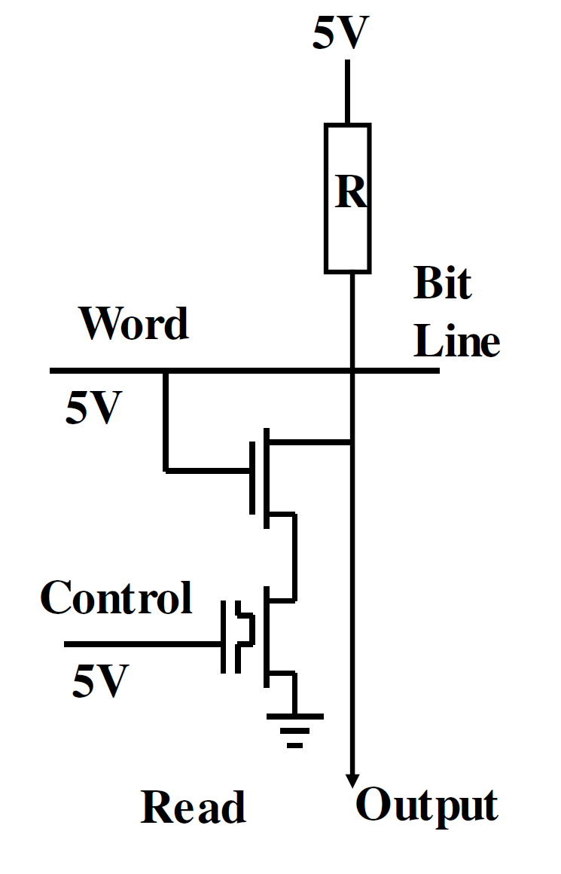
3b. Reading the cell
If the floating gate is charged with electrons the 5 volts on the control line will not be enough to turn that transistor on. Thus the output will be high.

Slide 13
3b. Reading the cell
If the floating gate is uncharged with electrons the 5 volts on the control line will turn that transistor on. Thus the output will be low.

Slide 14
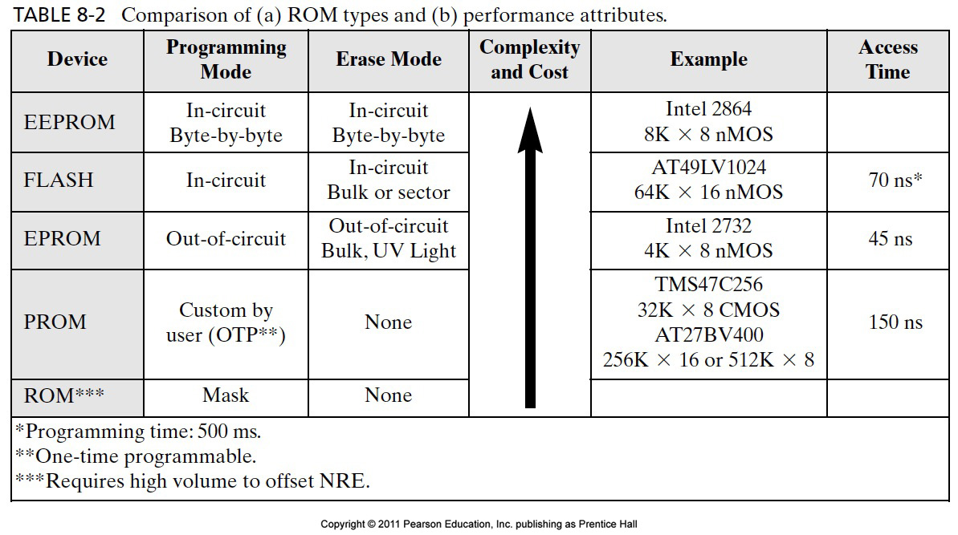
Comparison Between the Storage Devices:

Slide 15
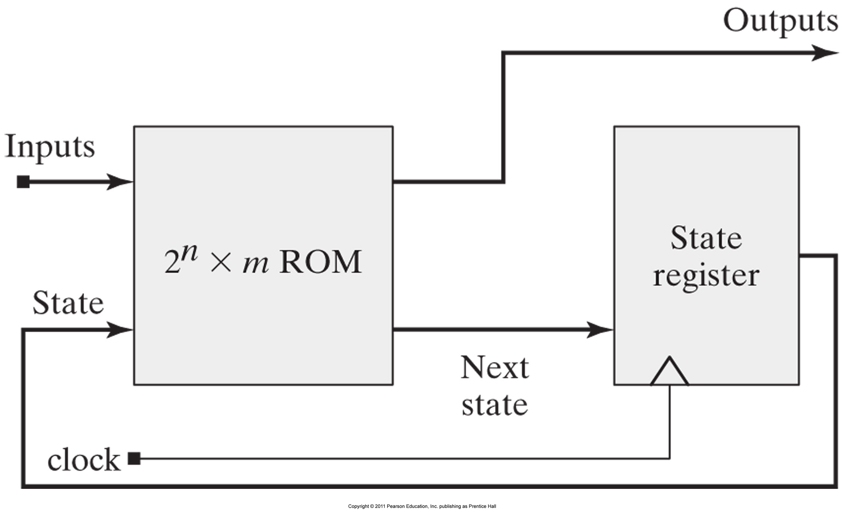
Block diagram for a ROM-based finite-state machine.

Slide 16
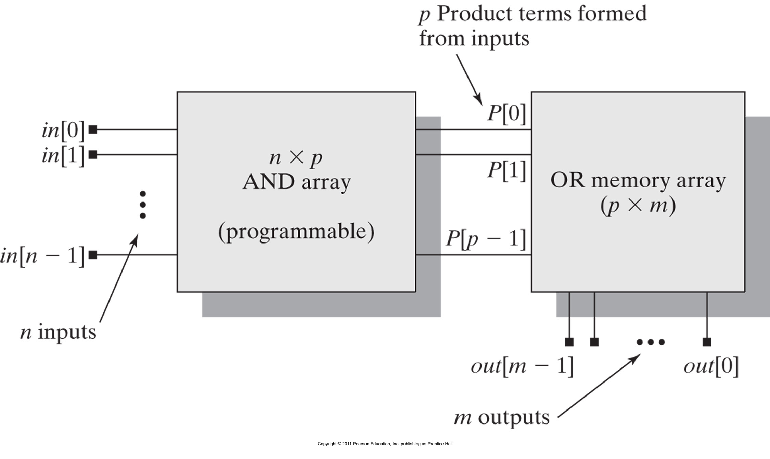
4. AND-OR plane structure of a PLA.

Slide 17
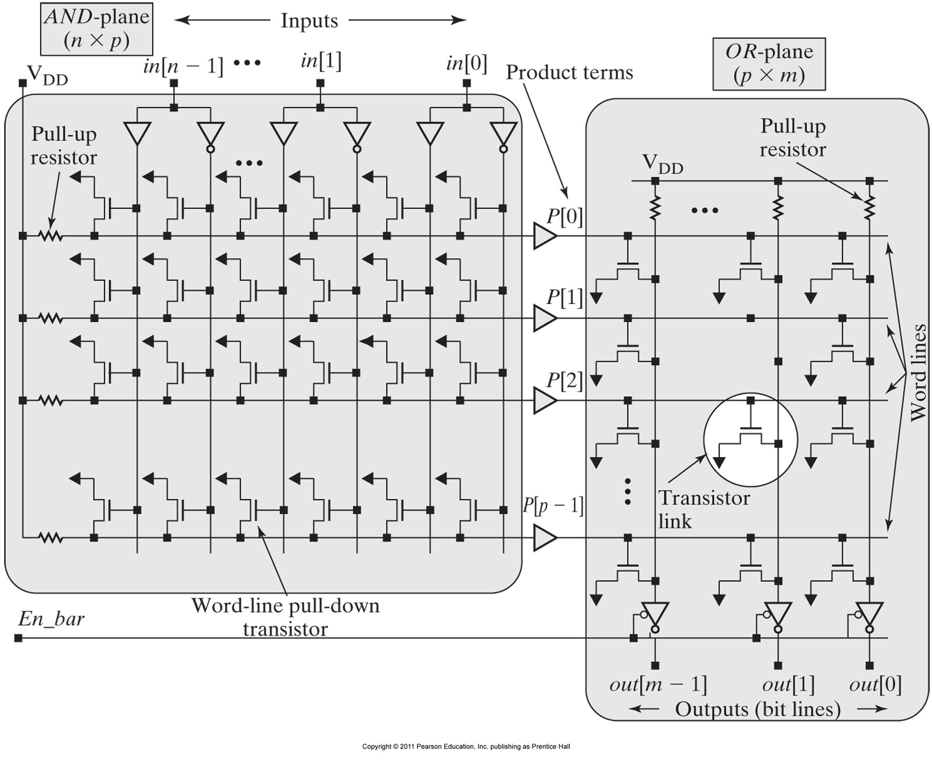
4. Circuit structure of a PLA

Slide 18
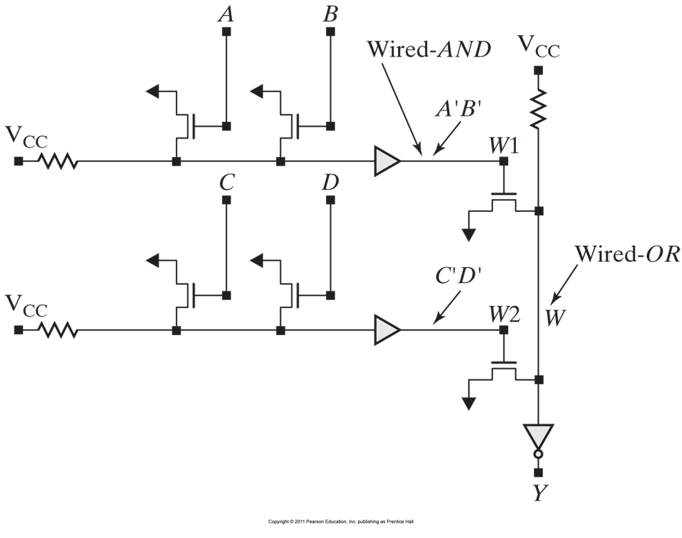
4. Wired-OR logic of a PLA

